Slide 1


Social Buzz

Slide 2


Today's agenda
Project recap
Problem
The Analytics team
Process
Insights
Summary

Slide 3

Social Buzz is a fast growing technology unicorn that need to adapt quickly to it’s global scale.
Accenture has begun a 3 month POC Focusing on these tasks:
An audit of Social Buzz’s big data practice
Recommendations for a successful IPO
Analysis to find Social Buzz’s top 5 most popular categories of content
Project Recap

Slide 4

Problem
Over 100000 posts per day
36,500,000 pieces of content per year!
But how to capitalize on it when there is so much?
Analysis to find Social Buzz’s top 5 most popular categories of content

Slide 5



Zulekha Mohamed
Data Analyst
The Analytics team
Marcus Rompton
Senior Principle
Andrew Flemming
Chief Technical Architect

Slide 6
Data Understanding
Process
1
2
Data Cleaning
3
Data Modelling
4
Data Analysis
5
Uncover Insights

Slide 7

Insights
16
Animal
May
Unique Categories
Most Favorite Category
Most Number of Posts

Slide 8
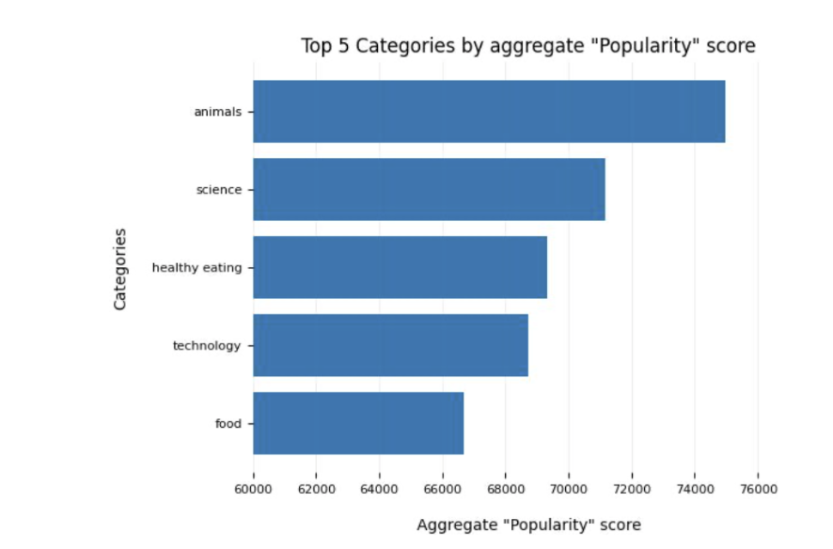

Slide 9
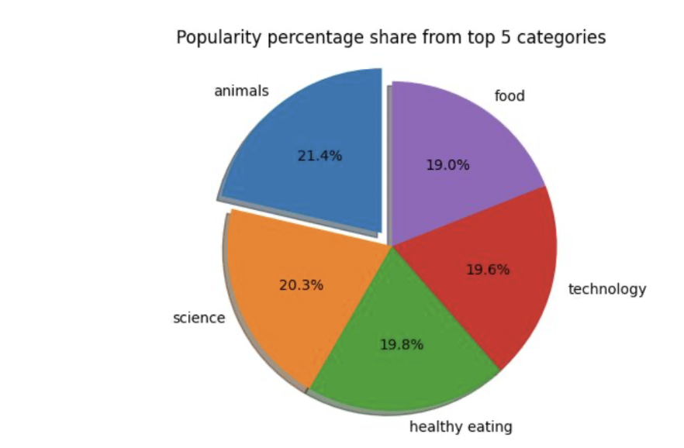

Slide 10

ANALYSIS
Animals and science are the two most popular categories of content, showing that people enjoy
"real-life" and "factual" content the most.
INSIGHT
Food is a common theme with the top 5 categories with "Healthy Eating" ranking the highest. This may give an indication to the audience within your user base. You could use this insight to create a campaign and work with healthy eating brands to boost user engagement.
NEXT STEPS
This ad-hoc analysis is insightful, but it's time to take this analysis into large scale production for real-time understanding of your business. We can show you how to do this.
Summary

Slide 11
Thank you!
ANY QUESTIONS?

